Slide 1
The Cost of the Quantum Transition
ECE 4301 Final Project Presentation
Group D – Joshua Deckman and Jack Pearson

Slide 2


The Goal
Report where the post-quantum transition will be costly vs cheap
Compare Diffie-Hellman (pre-quantum) and Kyber (post-quantum)
Sensitivity to adverse network conditions
Anticipation: Kyber much more sensitive to bandwidth, similar sensitivity to delay
Simulate on Raspberry Pi 5
Vs.
ECC Diffie-Hellman

Slide 3
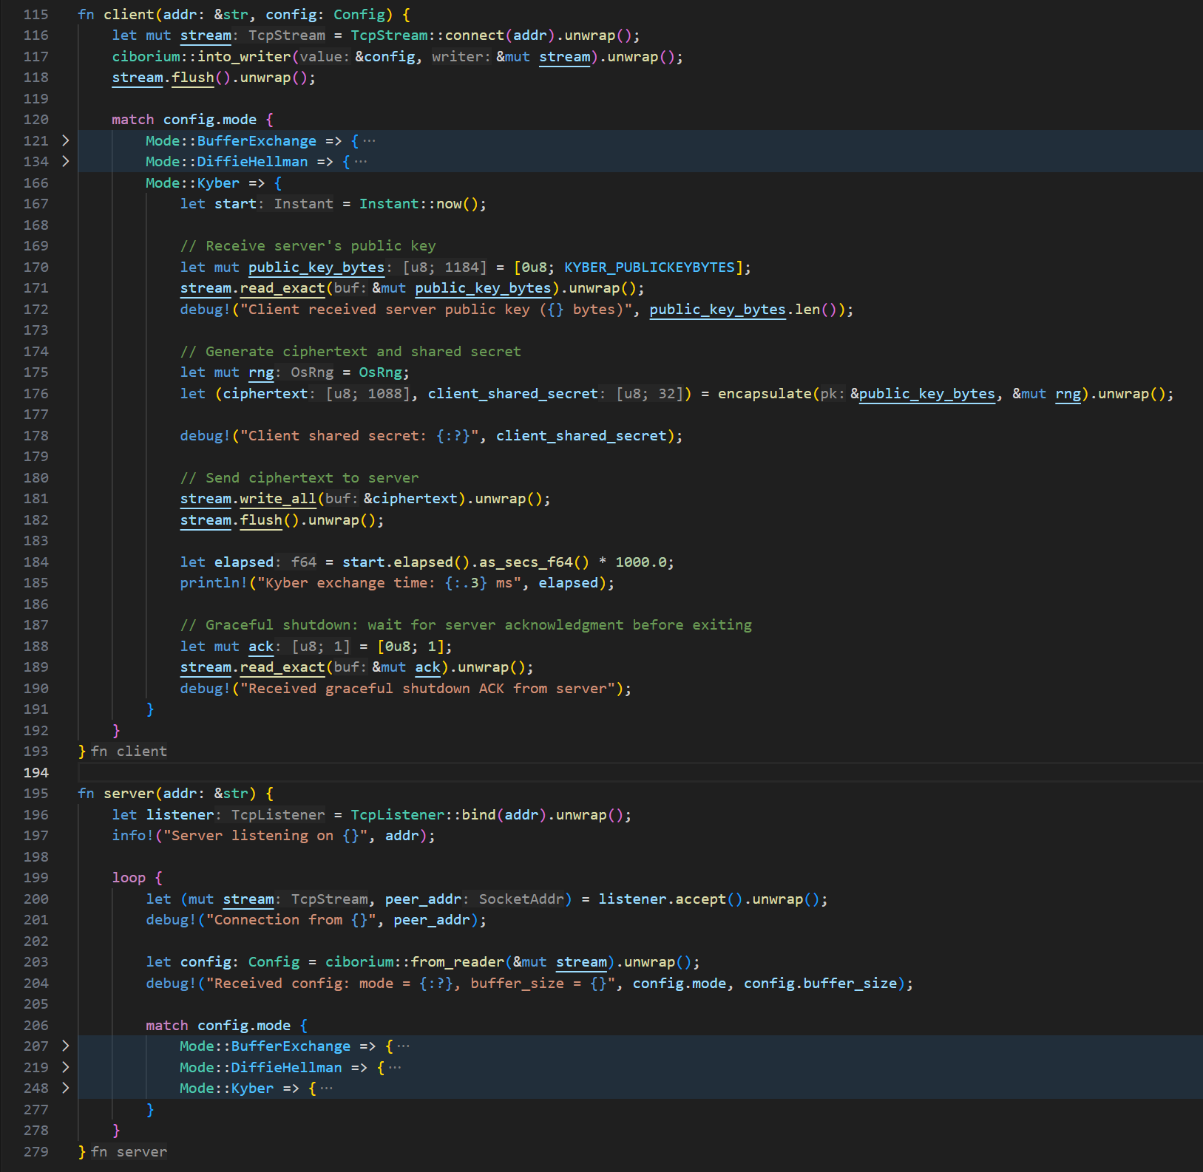
One Executable, Two Modes
Client/Server Topology
The client times key exchanges
Server
Notes:
Run in two terminals: Server in one, client in the other

Slide 4
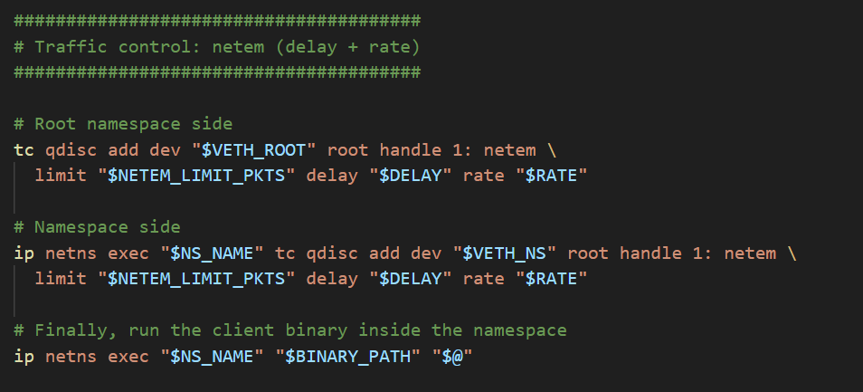
Network Namespace
Wraps client executable
Network parameters (such as bitrate) can be regulated
For testing, parameters were swept

Slide 5
Data Acquisition
Parses output with Regular Expressions
Python script to automate acquisition
Sweeps through specified network parameters
Writes results to CSV file
Network Delay (ms) | Network Rate (kbps) | Kyber Exchange Time (ms) | Diffie-Hellman Exchange Time (ms) | Difference (ms) | Ratio
0 | 50 | 324.307 | 83.551 | 240.756 | 3.8815454
0 | 100 | 156.39 | 40.297 | 116.093 | 3.88093406
0 | 150 | 104.758 | 27.144 | 77.614 | 3.85934276
0 | 200 | 78.965 | 20.562 | 58.403 | 3.84033654
0 | 250 | 63.49 | 16.635 | 46.855 | 3.81665164
0 | 300 | 53.154 | 14 | 39.154 | 3.79671429
0 | 350 | 45.776 | 12.114 | 33.662 | 3.77876837
0 | 400 | 40.248 | 10.708 | 29.54 | 3.7586851
0 | 450 | 35.979 | 9.61 | 26.369 | 3.74391259
0 | 500 | 33.448 | 9.519 | 23.929 | 3.51381448
0 | 550 | 29.924 | 8.015 | 21.909 | 3.73349969
25 | 50 | 412.148 | 198.92 | 213.228 | 2.07192841
25 | 100 | 257.326 | 140.809 | 116.517 | 1.82748262
25 | 150 | 205.701 | 127.67 | 78.031 | 1.61119292
25 | 200 | 179.917 | 121.097 | 58.82 | 1.48572632

Slide 6
Key Exchange Times
Inversely proportional to network rate
Directly proportional to delay (latency)
Similar response when latency-limited
Bandwidth is the interesting variable

Slide 7
Network Rate Analysis
Ratio between Diffie-Hellman and Kyber key exchange time is mostly independent from network rate
Approximately 3.8x more data needed for Kyber
At 550 kbps, the difference is about 22 ms.

Slide 8
Where does it matter?
Domain | Network Characteristics | Evaluation
GSO Satellite | 10kbit—220mbit, 500ms delay | No difference at 8mbit (2s), small difference at 10kbit: ~2.4s vs ~3.5s. PQ transition is cheap
Zigbee (IoT) | 1kbit—250kbit, 1ms delay | 2kbit: 3.7s vs 9.5s; 20kbit: 242ms vs 823ms; 200kbit: 25ms vs 83 ms. PQ transition is expensive
Internet | 512kbit—1gbit, 10-150ms delay | 3G (512kbit, 150ms): 609ms vs 633 ms; Gigabit ethernet (1gbit, 10ms) 41 ms vs 43 ms. PQ transition is cheap
Questions?
Notes:
Follow this with a demo and questions

